Slide 1
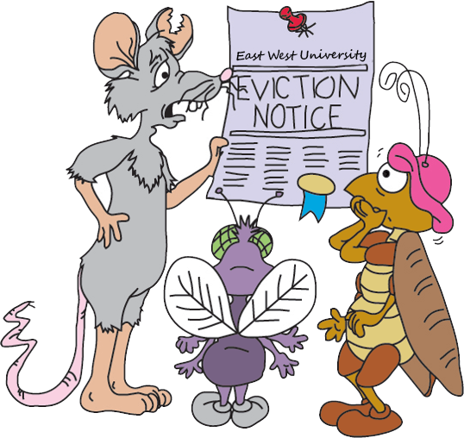
Pest Control

Slide 2
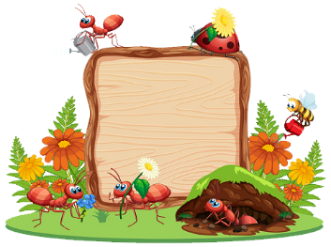
Submitted to
Course Instructor : Md. Nazmul Abedin
khan
Department : Department of
Mathematical and Physical
Sciences
Course Title : Engineering Chemistry-1
Course Code : CHE - 109
Section : 5

Slide 3
Submitted by
Name: Arman Sheikh
Department: Computer Science and Engineering
ID: 2021-3-60-015
Name: B M Shahria Alam
Department: Computer Science and Engineering
ID:2021-3-60-016
Name: Rafsun Islam Taskin
Department: Computer Science and Engineering
ID: 2021-3-60-024

Slide 4
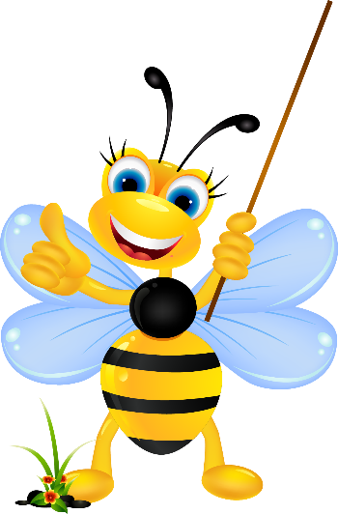
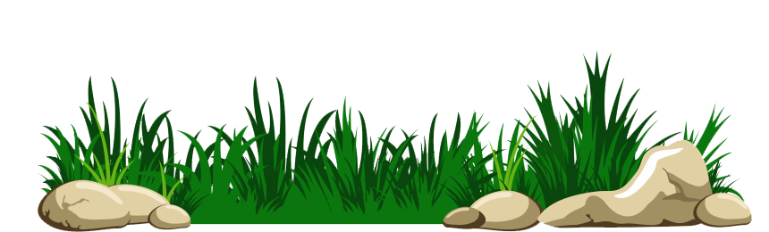
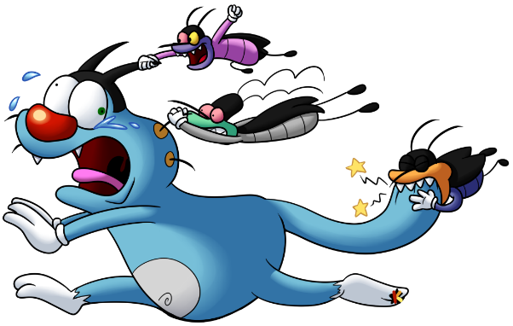
Why did we choose this topic?
We want to create awareness to the people about the bad effects of pesticide in our life and want to spread the message that pest control is needed for our house.

Slide 5

Introduction
What is a pest?

Slide 6
Introduction
A pest is a creature that is harmful to human. There is a chance that they can affect our health as well.
Some common names that we can mention

Slide 7
Introduction
* Mosquitoes
* Rats
* Cockroaches
* Ticks

Slide 8
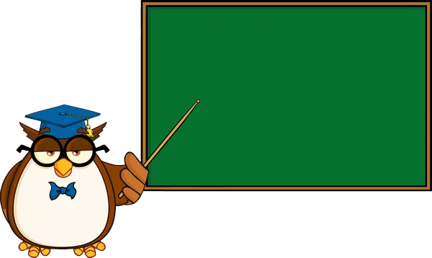
Introduction
What is pest control?

Slide 9
Introduction
Pest control is the process of controlling, managing, or removing undesirable insects and other pests from home. The most common method of pest control is the use of pesticides chemicals that either kill pests or inhibit their development.

Slide 10
Introduction
Pesticides are often classified according to the pest they are intended to control. For example, insecticides are used to control insects; herbicides to control plants; fungicides are used to control fungi

Slide 11
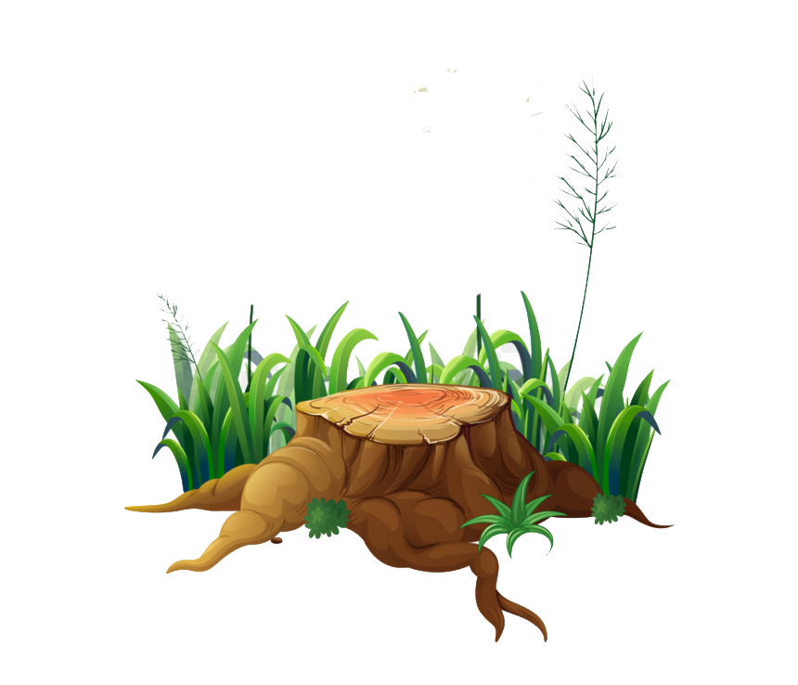

Types of pesticides
Insecticides insects
Acaricide mites, ticks
Attractant insects
Avicide birds
Bactericide bacteria
Fungicide fungi
Herbicides weeds

Slide 12
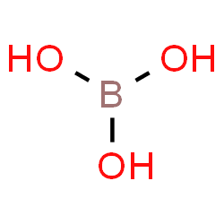
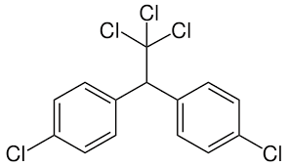
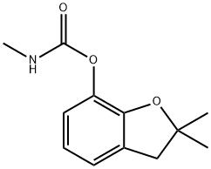
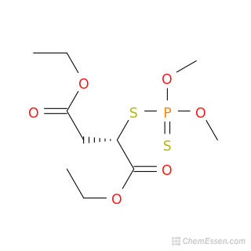
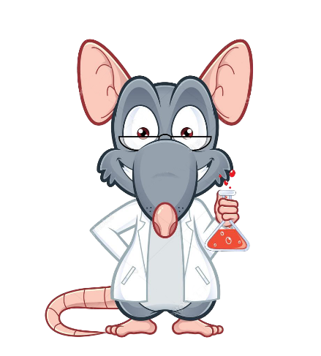
Chemicals for pesticides
Boric Acid
DDT
Carbofuran
Malathion

Slide 13
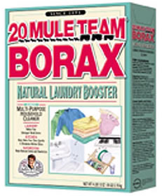
Chemicals for pest control
Feature
Boric Acid
Natural Acid
Odorless
Low toxic
(H₃BO₃)

Slide 14
Chemicals for pest control
Boric acid, also called hydrogen borate is a weak, monobasic Lewis acid of boron. It has the chemical formula H₃BO₃ (sometimes written B(OH)₃) . Boric acid is low in toxicity. However, in the form of borax (Na₂[B₄O₅(OH)₄]·8H₂O), it can be destructive to the eye and also be irritating to the skin.
Boric Acid
(H₃BO₃)

Slide 15
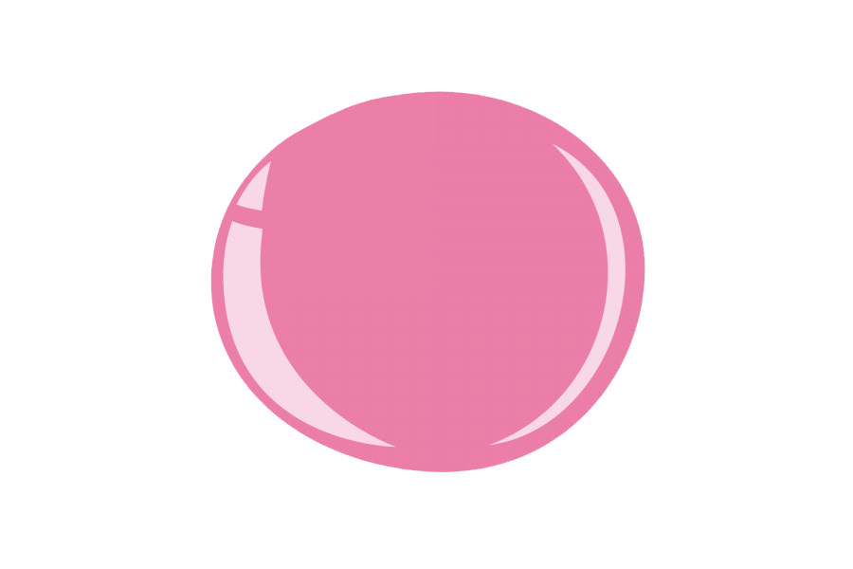
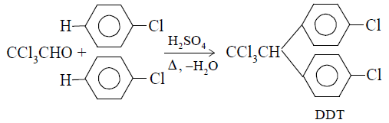
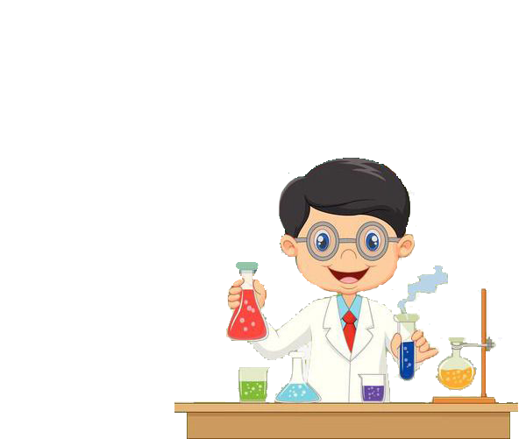
Chemicals for pest control
Feature
DDT
(C₁₄H₉Cl₅)
Synthetic insecticide
Colourless powder
Highly toxic

Slide 16
Chemicals for pest control
DDT is a remarkable molecule since it kills a wide variety of insect pests, such as houseflies, body lice, mosquitoes, Colorado beetles, and gypsy moths. DDT was developed as the first of the modern synthetic insecticides in the 1940s. It is a class 2 insecticide, meaning it is moderately toxic. Low to moderate exposure (10mg/kg) may result in nausea, diarrhea, and irritation of the eyes, nose, or throat, while higher doses (16mg/kg) can lead to tremors and convulsions.
DDT
(C₁₄H₉Cl₅)

Slide 17

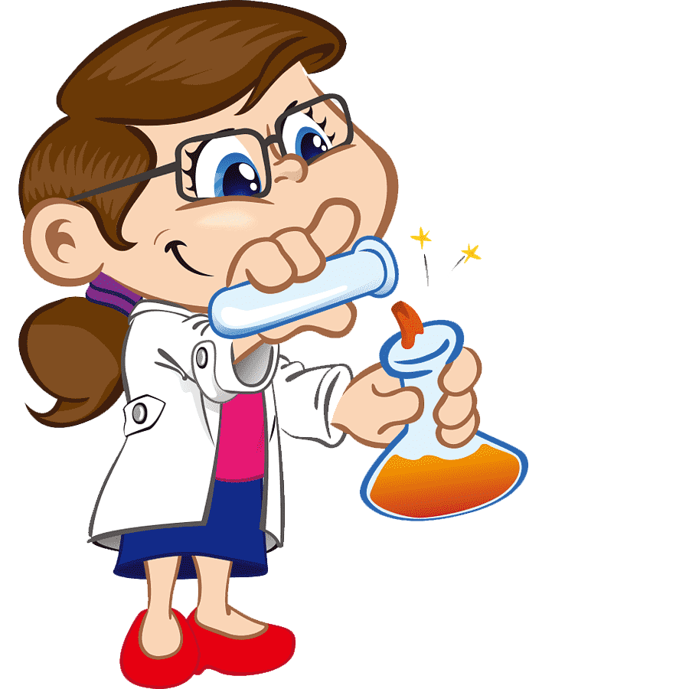
Chemicals for pest control
Feature
Carbofuran
(C₁₂H₁₅NO₃)
Crystalline solid
Carbamate ester
Soluble in water

Slide 18
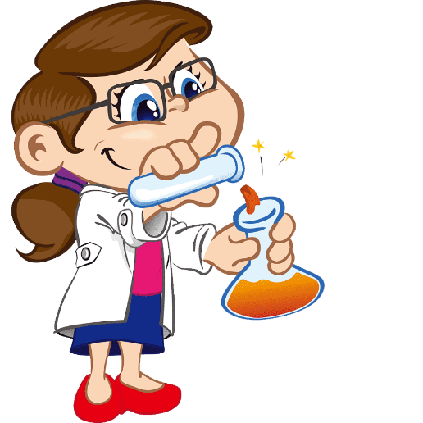
Chemicals for pest control
Carbofuran is a carbamate pesticide, widely used to control insects and nematodes on a wide variety of field crops. It is an odourless white crystalline solid. It has one of the highest acute toxicities to humans of any insecticide. 1 ml (1/4 teaspoon) can be fatal to humans. Contact with skin may burn skin and eyes. When exposed to heat or flames it may emit toxic oxides of nitrogen.
Carbofuran
(C₁₂H₁₅NO₃)

Slide 19
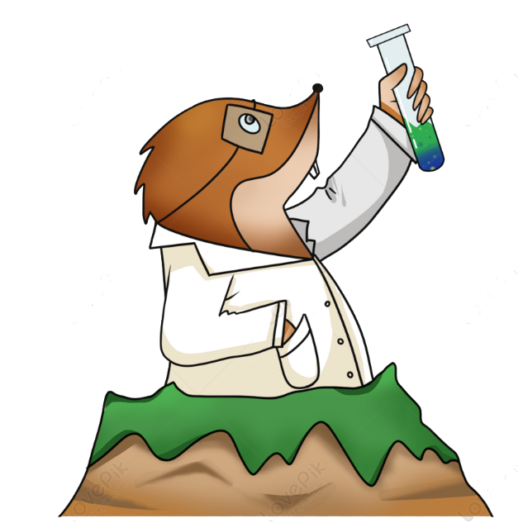
Chemicals for pest control
Feature
Malathion
Colorless to yellow-brown liquid
Suited for household and garden
Low toxic
(C₁₀H₁₉O₆PS₂)

Slide 20
Chemicals for pest control
Malathion is a man-made organophosphate insecticide that is commonly used to control mosquitoes. Malathion is a colourless to yellow-brown liquid with a characteristic unpleasant odour. Malathion is highly toxic to bees and mosquitos. Malathion is of low toxicity. Malathion 57% is pet safe if used as directed. Malathion in low doses (0.5% preparations) is used as a treatment for Head lice and body lice.
Malathion
(C₁₀H₁₉O₆PS₂)

Slide 21
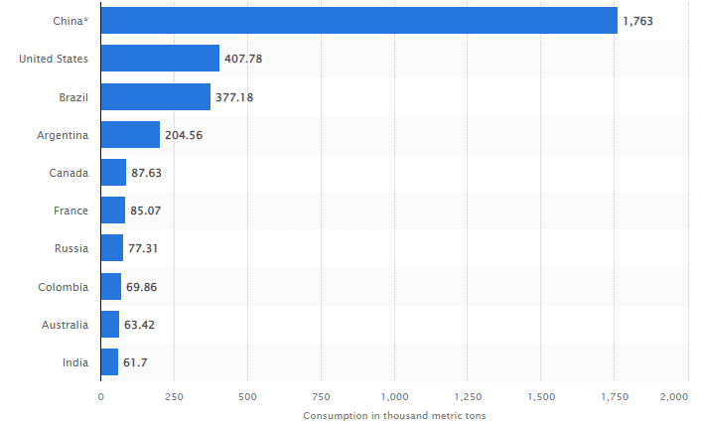
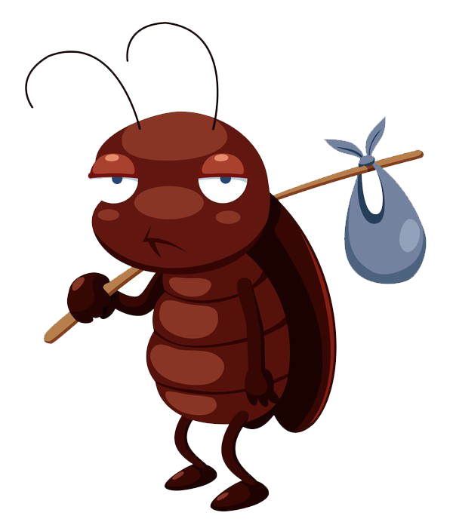
Consumption of pesticides worldwide
Source: Statista
https://www.statista.com/statistics/1263069/global-pesticide-use-by-country/?fbclid=IwAR361MSl2RGVO97C8W0zygs8ZIo8KQlst0WNjXu5ha_9pkEU5QykZG3eafU

Slide 22
Necessity of pest control
*Preventing damage to homes and structures:
Termites consume wood and wood products and carpet bugs, moths, cockroaches, and silverfish are also attracted to fabric, often using it as a source of food. For managing a home to keep it safe from termites and other pests requires pest control.

Slide 23
Necessity of pest control
*Reduces health risks:
Most of the pest that keeps roaming about in our house carries diseases that can be easily transmittable to humans. Pests can have harmful effects on your health and your family’s health. Cockroaches are the pests that can cause a child’s asthma, and they also carry millions of pathogens and bacteria cells along with them.

Slide 24
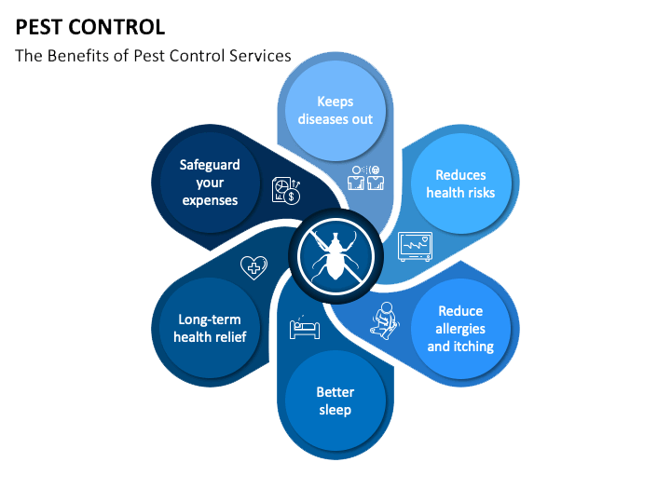
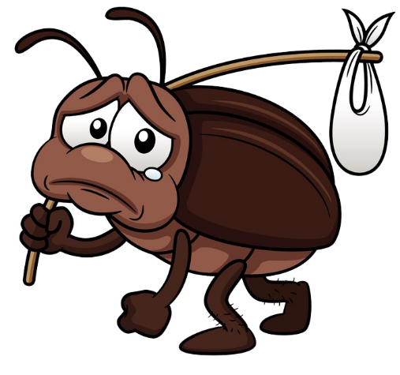
Necessity of pest control

Slide 25
Disadvantages of pest control
On human health
On environment
Other live forms
Long term and genetic effects
Pollination

Slide 26
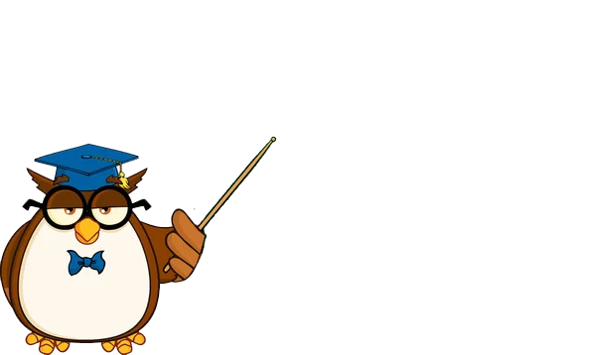
Disadvantages of pest control
“On human health”
Use of chemicals to prevent crops, the food is also added with toxic chemicals. Also, the farmers are at risk while using pesticide. Many pesticide chemicals also lead to different types of cancers in humans.

Slide 27
Disadvantages of pest control
“Pesticides negative affects”
The sprayed chemicals kills endangers other life forms like bees, butterflies, and soil-enriching organisms, which are helpful for crops. It causes land degradation and can have negative impacts on soil fertility in the long run. Humans are yet to discover the exact disadvantages of pesticides as the chemicals are causing the soil's fertility to deteriorate.

Slide 28
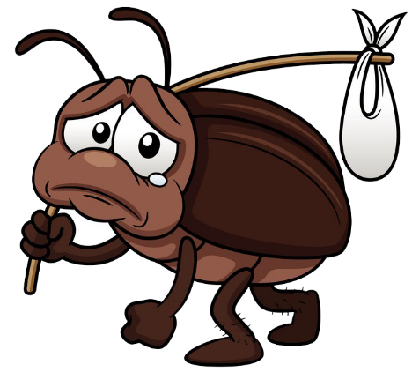
THANK
YOU

